Slide 1

ANNUAL GLOBAL MEETING 2020
Urban & Out of Camp

Slide 2
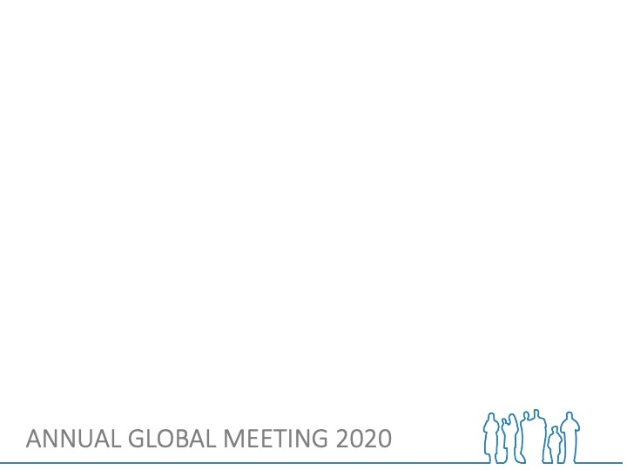
Agenda
Time | Topic | Min
13:45-14:00 | Recap day 3 | 15
14:00-14:50 | Session 1: Roundtable discussion on CCCM Area-based working paper | 50
14:50-15:00 | Break | 10
15:00-15:40 | Session 2a: Current experiences and learning from country operations | 45
15:40-16:00 | Session 2b: Participate to develop the focus for ABA WG - 2021 | 15

Slide 3

ABA WG –in time
ABA WG established
CCCM Global Cluster UDOC desk review
CCCM Global Cluster Mobile paper
ABA paper presentation
2011
2012
2013
2014
2015
2016
2017
2018
2019
2020
Annual CCCM Global retreat
Field findings/
UDOC presented
Recognition:
- CCCM actors providing assistance outside of camps
- to ensure a coordinated response at community level
CCCM ABA Case- studies documentation
2015-2020
Piloting and practice in difference countries/CCCM actors
CCCM Global Cluster ABA positioning paper
Area-based Working Group
2020 Global CCCM Cluster retreat
Notes:
2011 Annual CCCM Global retreat it was recognised that CCCM actors are already involved in providing assistance outside of camps (facilitating return, colleting population data of displaced population living with host community, supporting people residing in the camp but working outside,… ). Recognition that CCCM response structures – in outside camps- can assist in identifying and monitoring gaps in relation to service provision and also help to ensure a coordinated response at community level. It was also recognised that there is a lack of guidance on common approach for CCCM practitioners in these contexts.
2013-2014 CCCM Global Cluster UDOC desk review (published 2015)
The desk review explored how CCCM resources and experiences can be applied to addressing the needs of displaced people outside camps, in particular in urban environment. It identified CCCM-related experience of community support activities that are already being used outside camps and/or can be adapted. The desk review overview was developed for CCCM practitioners to better understand dynamic outside camps. The study 5 CCCM key crucial areas of work:
governance and community participation,
information management,
monitoring and advocacy for provision of protection and key services,
advocacy for durable solutions and capacity building.
The desk review proposed a possible model: Centre for Communication and Community Management.
One of the recommendations was piloting the proposed model.
In the desk review is mentioned that the Center should relate to a specific geographical areas (ABA) in the case studies described as “catchment area” – Iraq/ afghanistan
2015-2019
Piloting in difference countries, different ways, different organisations. NRC UDOC in Gaza, Lebanon, Greece, Iraq, Afghanistan (now exploring Iran and Myanmar). Other agencies testing (see case studies). Community Center Iraq – multi agencies efforts
Retreat 2015
Introduce ABA concept. Presentation of the paper of Elisabeth Parker, start to reflect more in depth about the link between work of CCCM outside camps and ABA. (In the retreat 2016 Elisabeth Parker was online and presented the paper)
Retreat 2016
(In the retreat 2016 Elisabeth Parker was online and presented the paper)
Retreat 2017
First finding from the field. NRC presenting UDOC, Acted-Impact on the area-based assessment tool
2018 Working group on ABA/Mobile/Outside camps.
The differences and synergies between these different terms still a bit unclear
Retreat 2018
Sharing experience of mobile approach (Yemen, Iraq, Lebanon)
2018 CCCM represented at the GSC ABA working group
2019 ABA/Mobile working group
Guidance on mobile, webinar,….
Terminology: important to have a slide where we summarise our we see (as CCCM) these different terms:
ABA, Mobile, UDOC…..

Slide 4
Round table speakers
Monica Ramos, Global WASH Cluster, (UNICEF)
Seki Hirano, Co-lead Homes & Communities (CRS)
Randa Hassan, (OCHA)
Facilitators, CCCM Global Cluster Coordinators:
Dher Hayo (UNHCR)
Wan Sophonpanich (IOM)

Slide 5

10 min Break

Slide 6

Current experiences
Afghanistan
“Transition to an area-based response in mixed urban & informal settlement”
Mate Bagossy (NRC)
Ethiopia
“ReDDS area-based planning training”
Elena Valentini, Jason Lee Bell, Patience Kiara ( ACTED/ReDDS)
Iraq
“Exit strategies and localisation of Community Centres (UDOC)”
Shadan Namiq, Ayman Aljawadi (NRC)
Yemen
“Developing an area-based model for Yemen”
Ruxandra Bujor (UNHCR)
Notes:
-Current experiences and learnings of CCCM practitioners applying different ABA aspects in their programming

Slide 7
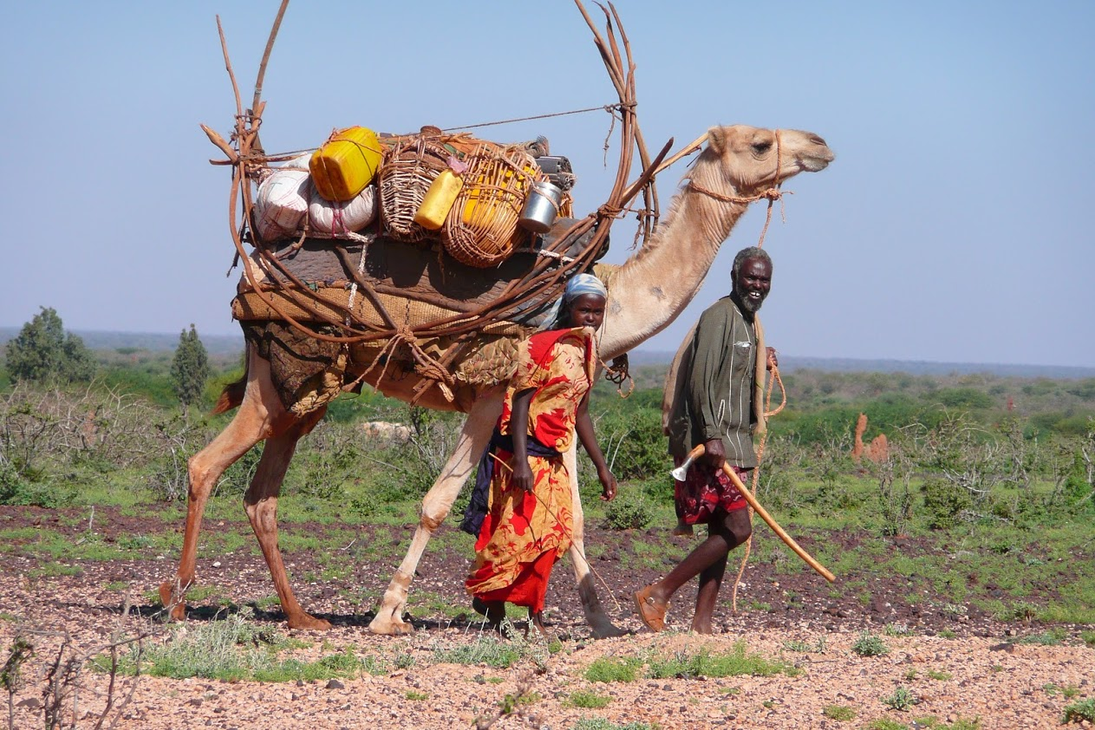
Area Based Durable Solutions Planning
Training curriculum

Slide 8






Priority policy processes
Objectives of the workshop
What is it?
How to do it?
Monitoring and Evaluation
A step by step methodology
Area-Based Solutions Planning
Planning
Preparation
Notes:
Why? Most responses to forced displacement within our region continue to be primarily status-based and fragmented by sector/cluster; the training intends to support actors in determining how to adopt a rights and needs-based approach within their area, while working towards sustainable (re)integration.
What? The ReDSS area-based training curriculum was developed in early 2020. These are the main objectives and training modules of the workshop, which has been designed for 2.5 days.
The first sections are dedicated to unpacking what durables solutions, ABA (and potentially social cohesion and conflict sensitive planning) are…answering the question: “What are we talking about?” and that the last three sessions will be more the “how do we do it?” with a step by step methodology from preparation to monitoring. The last session of the workshop is the participants’ session, an opportunity to develop their recommendations on “what to do next to apply an ABA to their context.”
The 3 primary objectives of the training are as follows:
- Explain the added value of area-based approaches to plan for durable solutions and enhance social cohesion in displacement contexts.
- Apply area-based approach elements and principles and link them to the durable solutions planning cycle.
- Explain how to lead and/or take part in context specific, inclusive and government-led durable area-based solutions processes, meaningfully involving a wide range of actors.
Who? The training was designed for not more than 30 participants (in order to ensure a suitable size for discussion and interaction) comprising multi-stakeholders, including policymakers, programing practitioners, development actors, and other key actors at local levels within a specific displacement-affected area.

Slide 9

Methodology and lessons learned
Participatory
Practical
Context-specific
Piloted in Jigjiga, Somali Regional State, Ethiopia in March 2020
Lessons learned, and participant recommendations
Notes:
How?
- The workshop is participatory, and participants are expected to contribute to the proposed discussions and activities;
Discussions and activities are based on the local context (to be clearly defined for each workshop) and progressively lead to recommendations to be agreed on in each context.
The area-based training was developed based on the context of Jigjiga, Somali Regional State, Ethiopia, which has significant numbers of many displacement affected communities (including refugees, IDPs, returnees, and host communities). However, the training was developed in a way that the materials can be contextualized to different areas, and ReDSS plans to use the training in other contexts within the Horn of Africa.
Lessons learned:
- For the initial pilot workshop, evaluations were provided by participants after each session. Feedback provided by participants were used to finalize the training tools and develop an evaluation report. A follow up evaluation was also done 4 months after the training to monitor longer-term learning.
- Recommendations from participants included that the training would be most useful at the local level (woreda/district, in the Ethiopian context), or wherever planning processes typically begin.
- Based on the recommendations, ReDSS plans to roll out the training in different contexts, and plan to repeat the training over time, as part of ReDSS’ iterative approach to learning.
- In Ethiopia, ReDSS plans to provide the area-based training to woreda level actors, and to translate the training tools into Somali language in early 2021.

Slide 10
ABA WG Focus for 2021:
Looking back on 2020 ABA WG activities:
  Webinars as part of “CCCM Tuesday” focus Covid-19
  Drafting process of the CCCM Global Cluster
  position paper on ABA
  - WG meetings and retreat organisation
Looking forward to 2021 focus:
  - 2 main topics and polls

Slide 11
Please vote!
1) What main aspects of ABA should be the WG’s focus for 2021 ?
2) What activities and modalities do you think are most
useful for the WG?
Notes:
Mentimeter here

Slide 12

Thank you for participating!
Area-Based Approach Working Group:
https://cccmcluster.org/global/Area-based-Approach-Working-Group
Giovanna Federici, giovanna.federici@nrc.no
Annika Grafweg, agrafweg@iom.int

